Slide 1

Training a Neural Network with Backpropagation
Using cross entropy

Slide 2
2-2-2
Network architecture: 2-2-2 (2 input neurons, 1 hidden layer with 2 neurons, 2 output neurons)
Loss function: Cross-Entropy with softmax output.
Goal: Show the forward pass, compute loss, and then do full backpropagation with weight/bias updates.

Slide 3
x1=1
x2=0
b1=0.01
Z=1*0.1+0*0.2+1*0.01=0.11
Z=0.11
0.1
0.2
0.3
0.01
0.4
Z=0.32
0.02
Z=1*0.3+0*0.4+1*0.02=0.32
Input Layer Hidden Layer output

Slide 4
x1=1
x2=0
b1=0.01
a=sig(0.11)= 0.5275
Z=0.11
0.4
0.1
0.2
0.5
0.3
0.01
0.6
0.4
Z=0.32
0.7
a=sig(0.32)= 0.5793
0.02
Input Layer Hidden Layer output

Slide 5
x1=1
x2=0
b1=0.01
Z=0.5(0.5275)+0.6(0.5793)+0.03=0.2637+0.3476+0.03=0.6413
Z=0.11
a=0.5275
0.1
0.5
0.2
0.6
0.3
0.01
0.7
0.03
Z=0.32
0.8
0.4
a=0.5793
0.02
0.04
Z=0.7(0.5275)+0.8(0.5793)+0.04=0.3693+0.4634+0.04=0.8727
Input Layer Hidden Layer output

Slide 6
Softmax!
z1=0.6413
z2=0.8727 Apply Softmax:
Y1(hat)= e(z1)/e(z1)+e(z2)=1.898/(1.898+2.393)=0.4425
Y2(hat)=
e(z2)/e(z1)+e(z2)=1.898/(1.898+2.393)=0.5575
Predicted values

Slide 7
Cross Entropy loss error
L=−i∑​yi ​ln y(hat)​i​ since y is [1,0]
➔L=-ln(0.4425)=0.816

Slide 8
Output Layer Backpropagation
y1 error (y1 δ =loss gradient) =0.4425-1= -0.5575
y2 error =0.5575-0= 0.5575 Gradients wrt output weights

Slide 9
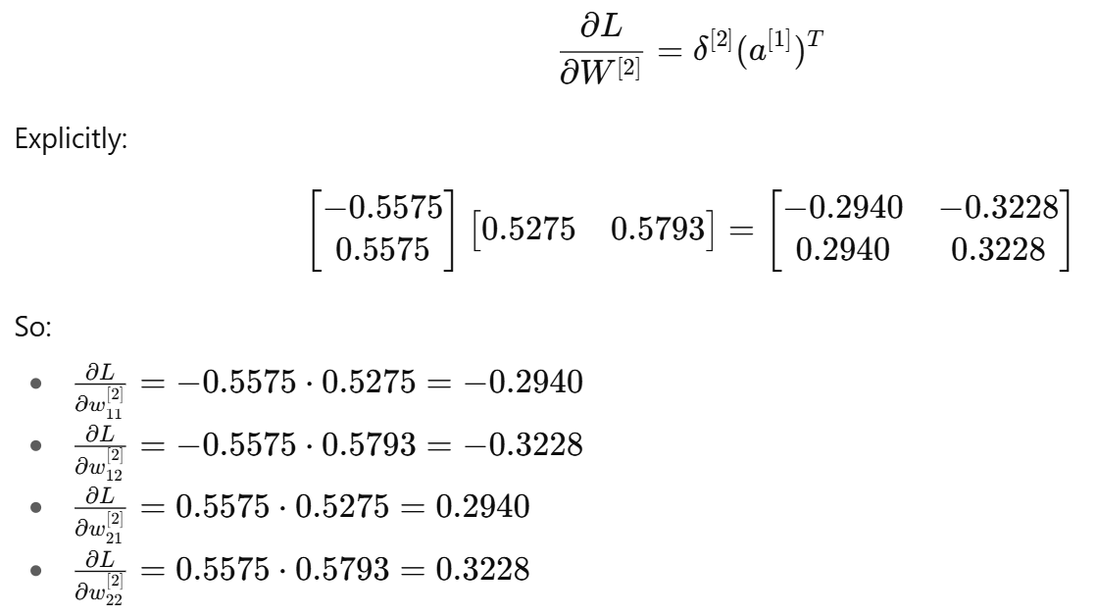
Gradients wrt output weights

Slide 10
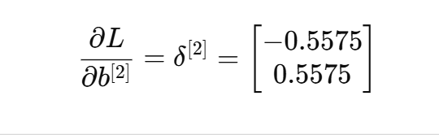
Gradients wrt output biases:

Slide 11

Hidden Layer Backpropagation
We propagate error backward
Compute:
First element = 0.5(−0.5575)+0.7(0.5575)=−0.2788+0.3903=0.1115
Second element = 0.6(−0.5575)+0.8(0.5575)=−0.3345+0.4460=0.1115

Slide 12
Multiply by sigmoid derivatives
Derivative of sigmoid = s*(1-s) σ′(0.11)=0.5275⋅(1−0.5275)=0.2493 σ′(0.32)=0.5793⋅(1−0.5793)=0.2430
Δ1=0.1115*0.2493 = 0.0278
Δ2=0.1115*0.2430 = 0.0271

Slide 13
Gradients wrt hidden weights
0.0278
0.0271 Weight Updates
With learning rate η=0.1 w1=w1-0.1*0.0278
…..

Slide 14
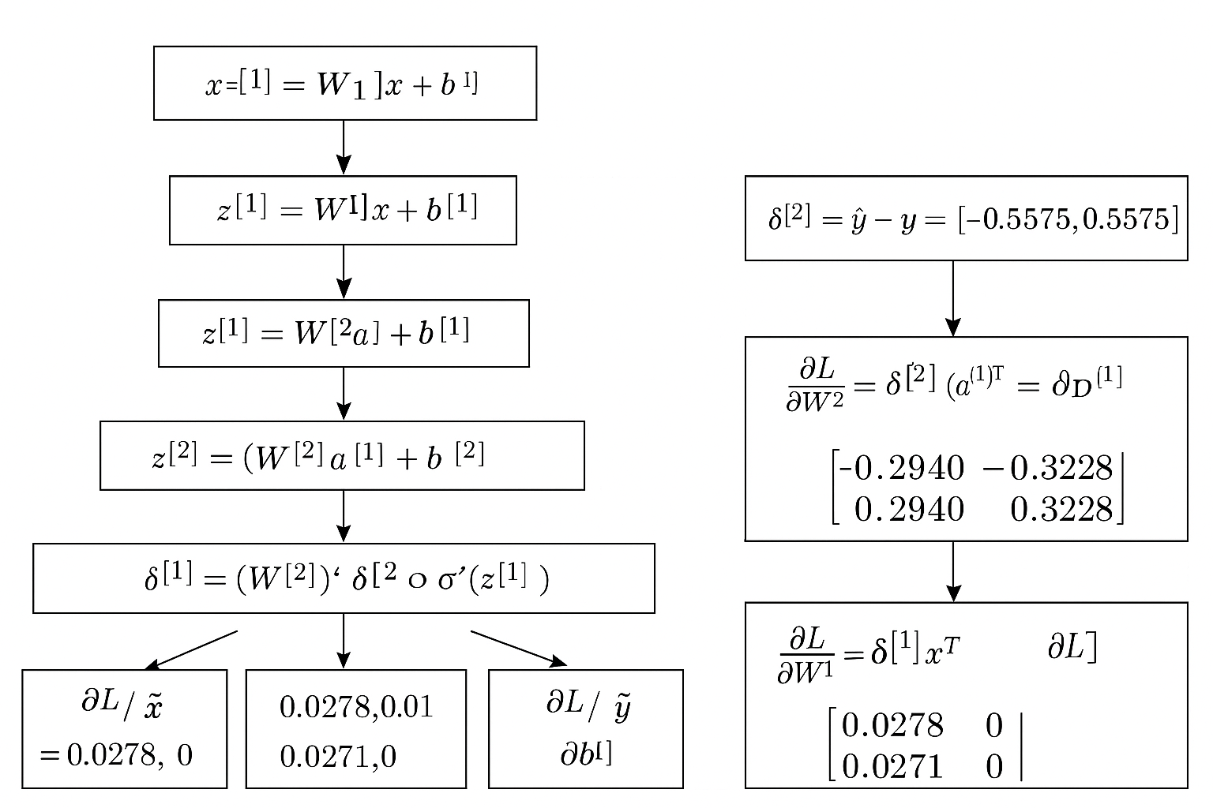

Slide 15
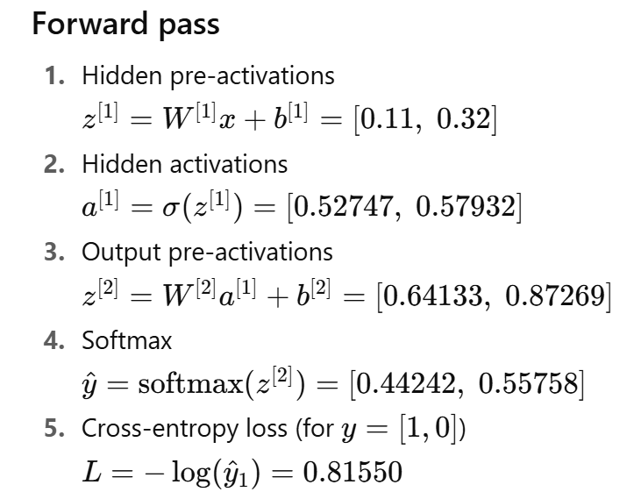

Slide 16
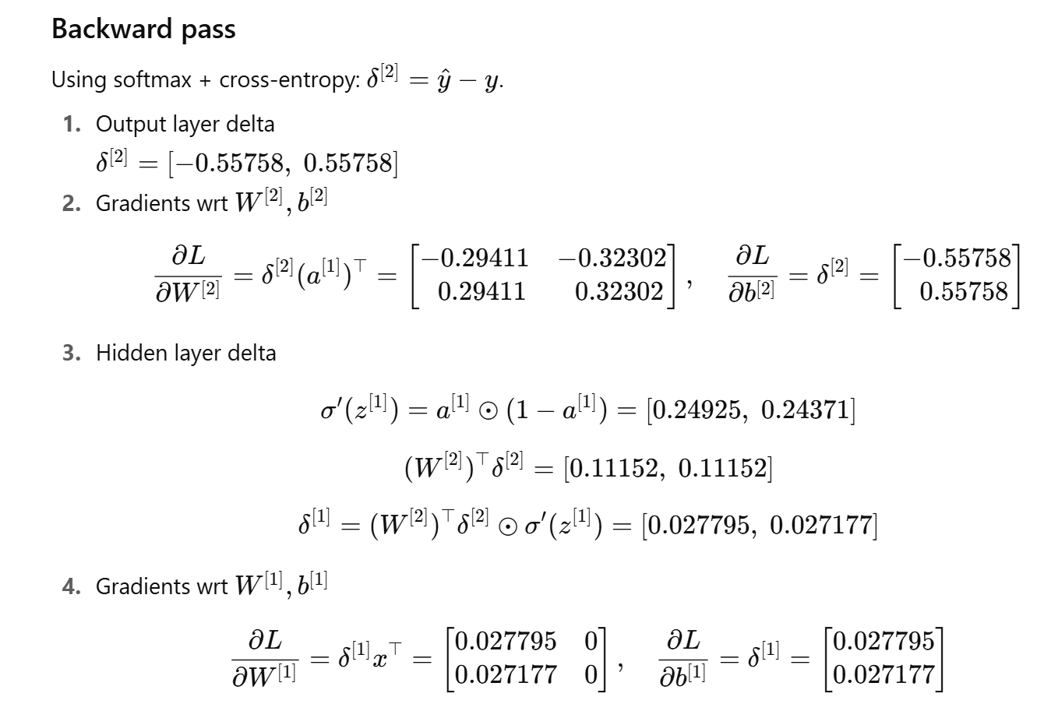

Slide 17
